Slide 1
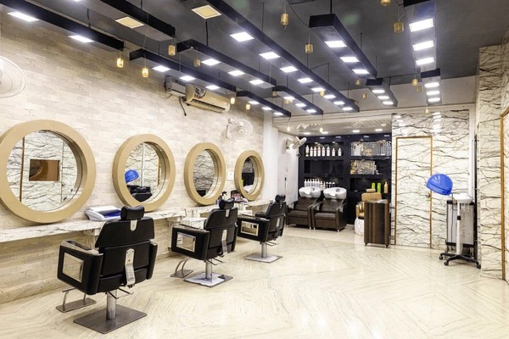
CAPSTONE PROJECT
Online Saloon Service Application
TEAM-C, BATCH - 8
JAVA FULL STACK Spíing Boot
Name: Atul Kumar Mobile No : 9508973152
E-mail: atulk2512001@gmail.com Date: Aug 30, 2024

Slide 2
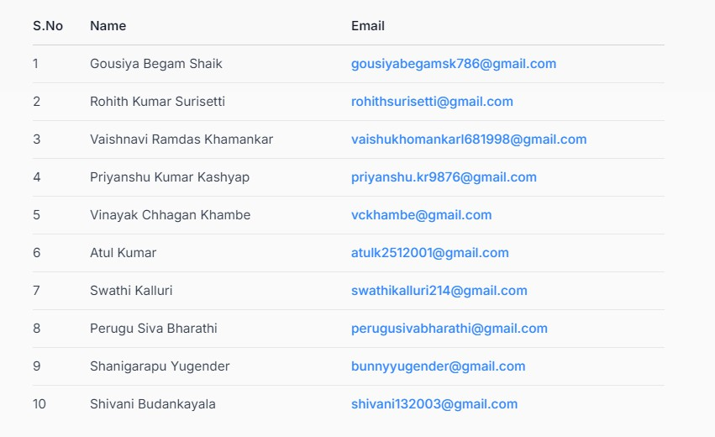
Team Leader : Atul Kumar
Spring Planning Sheet
Overview of Requirements
Technologies
Java
Spring Boot
Spring Cloud
Spring Data JPA
MySQL/MariaDB
RESTful APIs

Slide 3
Main Features
Admin Management
Services management
Staff management
Bookings management
Customer management
User Functionalities
Browse services
Book appointments
Manage bookings
Microservices
Service Registry and Discovery
Observe all services in one place.
Indicate service status (UP/DOWN)
Load balancing
API Gateway
Validate requests
Route requests
Authentication Service
User authentication
User registration
JWT token generation
Role-based access control

Slide 4
Service Management Microservice
Manage salon services (CRUD operations)
Staff Management Microservice
Manage staff details
Manage staff assignments
Booking Management Microservice
Handle appointment scheduling
Manage bookings
Contain booking history
Customer Management Microservice
Manage customer profiles
Planning
Requirements Gathering (1 day)
Understand features needed for admin and user modules.
Identify required microservices
Architecture Design (1 day)
Design microservices architecture
Set up Service Registry (Eureka) and API Gateway

Slide 5
Development
Day 1-3: Service Registry, API Gateway, and Authentication
Service Registry
Set up Eureka Server for Service Registry & Discovery
API Gateway
Implement API Gateway for routing requests
Authentication Service
Develop Authentication Service for user login, registration, and JWT token generation
Day 3-4: Service Management, Staff Management, and Booking Management
Service Management Microservice
Build Service Management Microservice (CRUD operations for services)
Staff Management Microservice
Implement Staff Management Microservice (CRUD operations for staff)
Booking Management Microservice
Develop Booking Management Microservice (appointment scheduling, booking status management)
Day 5-7: Customer Management and Remaining Tasks
Customer Management Microservice
Build Customer Management Microservice (profile and booking history management)
Remaining Tasks
Complete any remaining tasks or features

Slide 6
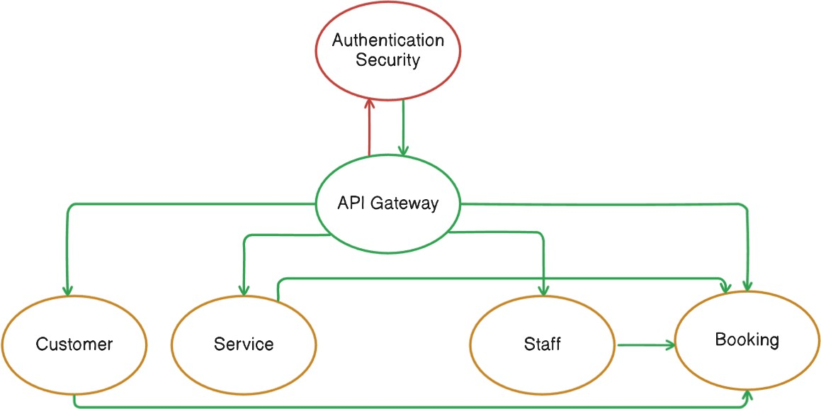
Database Design
A Database Design shows the tables, their fields, and relationships.
Tables:
users: id, username, password, role
services: id, name, detail, price,type
staff: id, name, details,gender,serviceId
bookings: id, user_id, service_id, staff_id, time, status
Relationships:
bookings table links users, services, and staff.
Use Case Diagrams:-

Slide 7
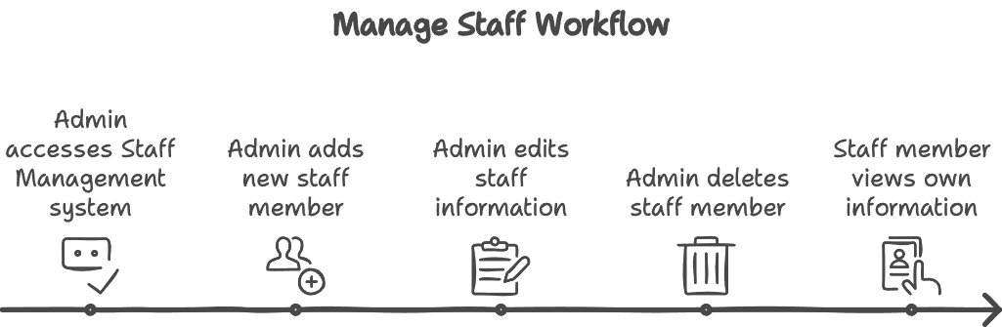
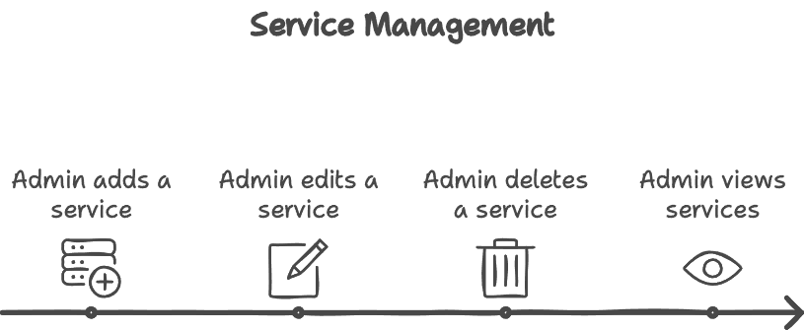
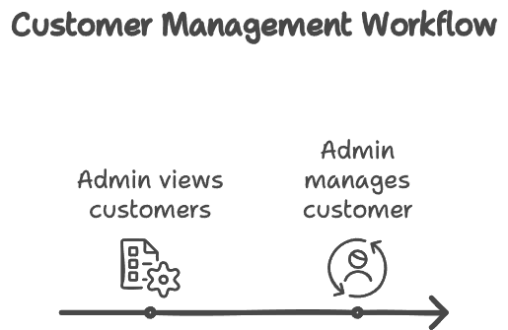
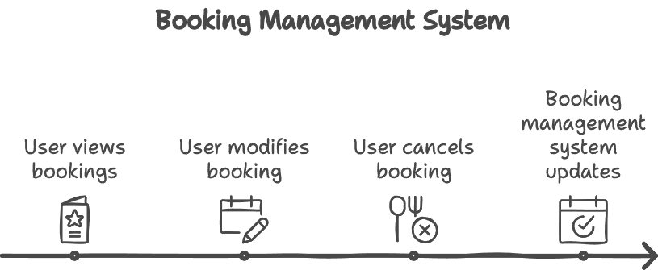

Slide 8
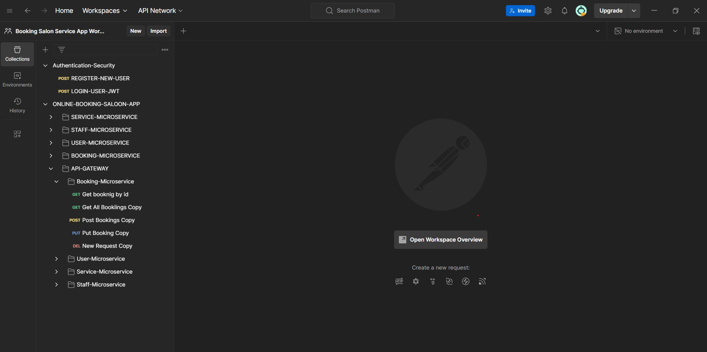
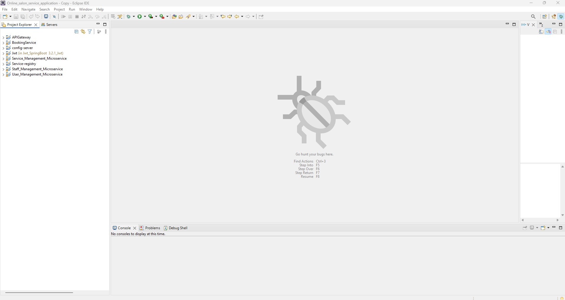
Postman Folder Structure
Eclipse Folder Structure

Slide 9
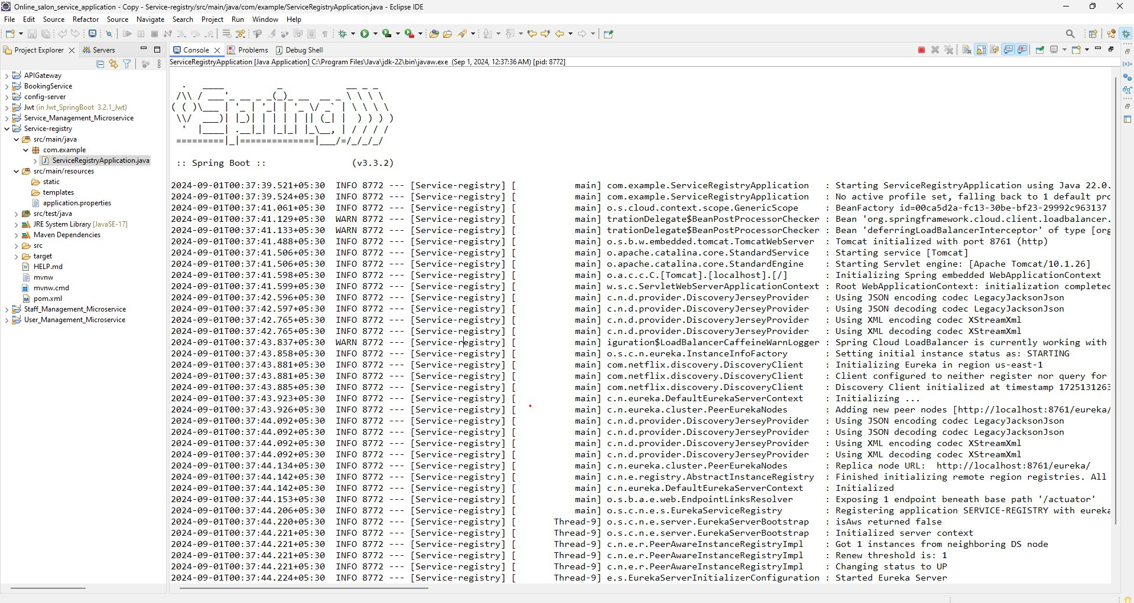
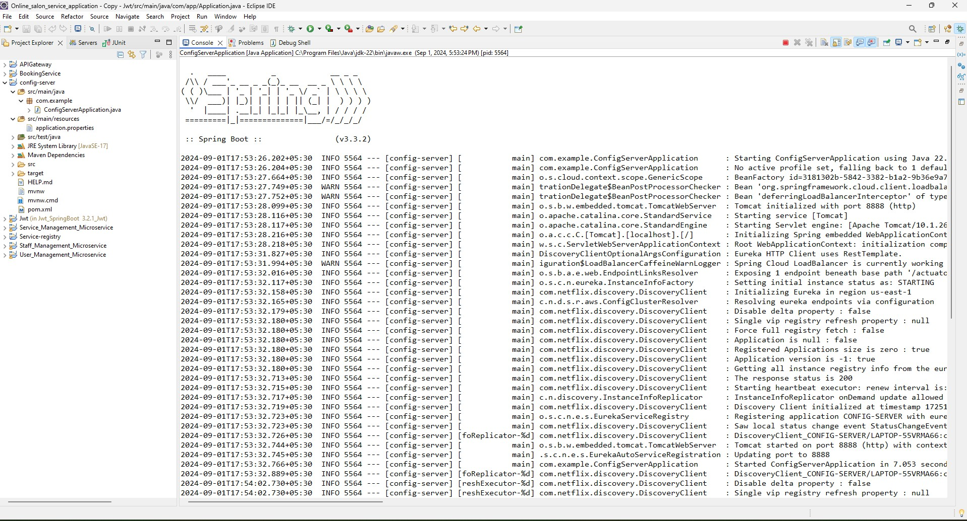
Running Service Registry
Running Config Server

Slide 10
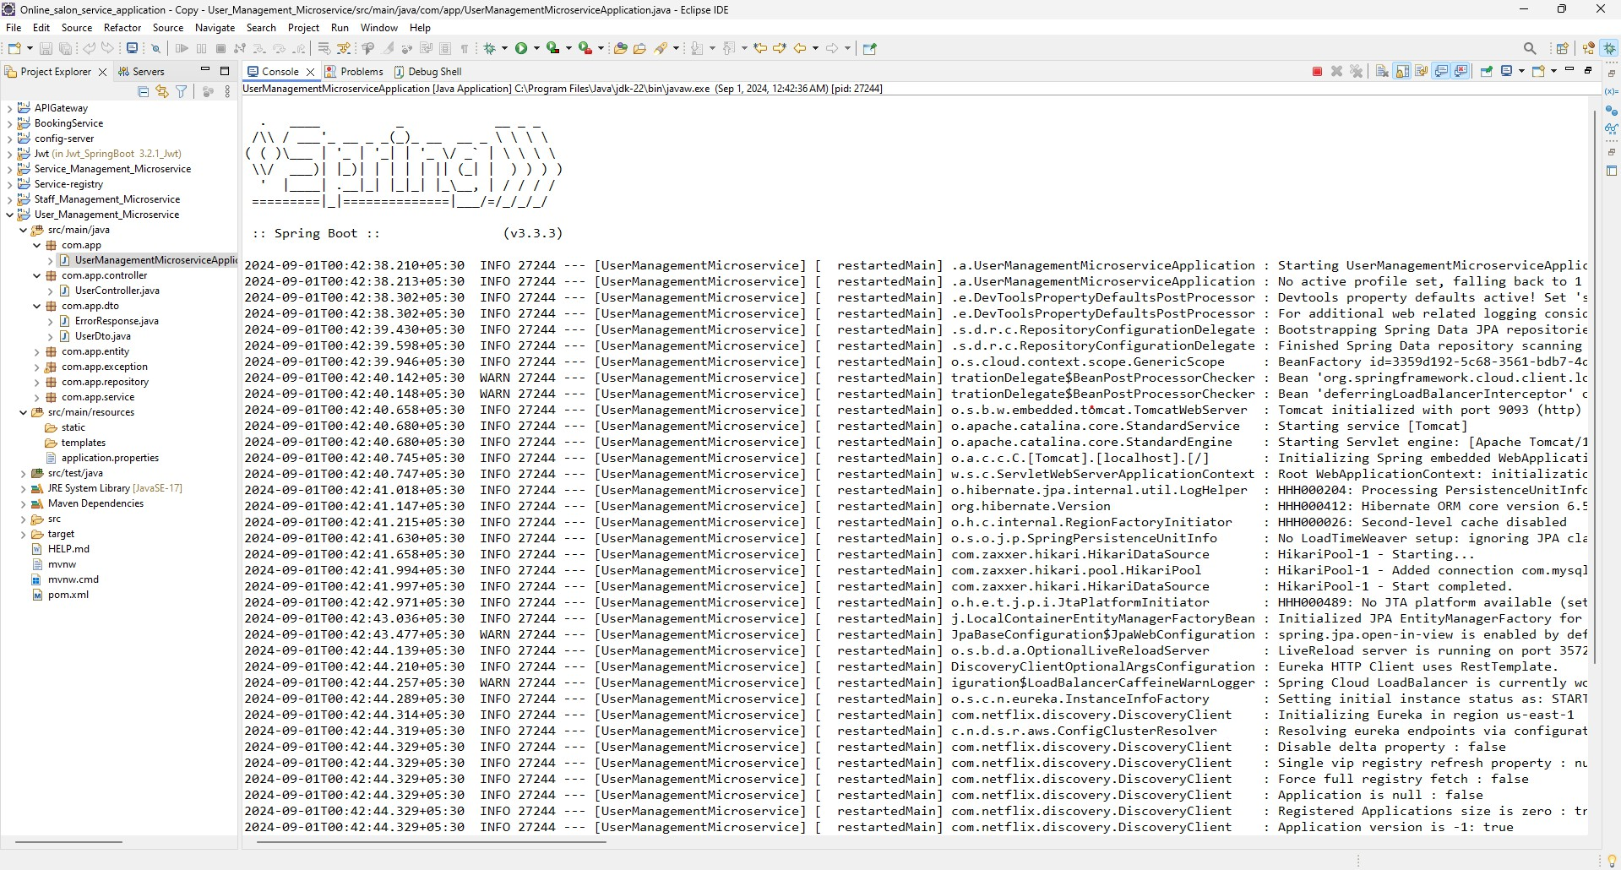
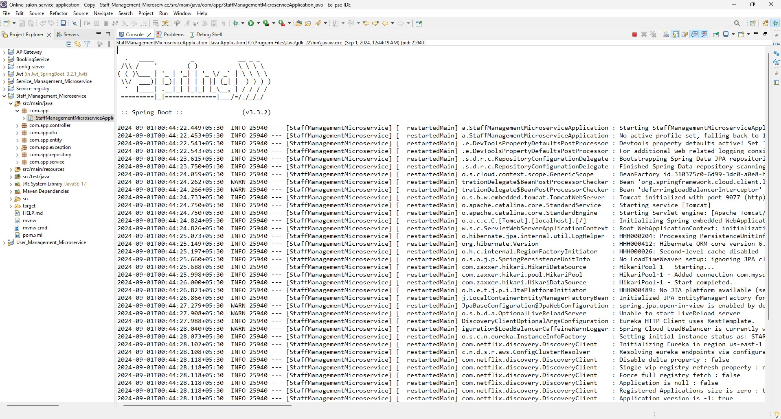
Running User Management Microservice
Running Staff Management Microservice

Slide 11
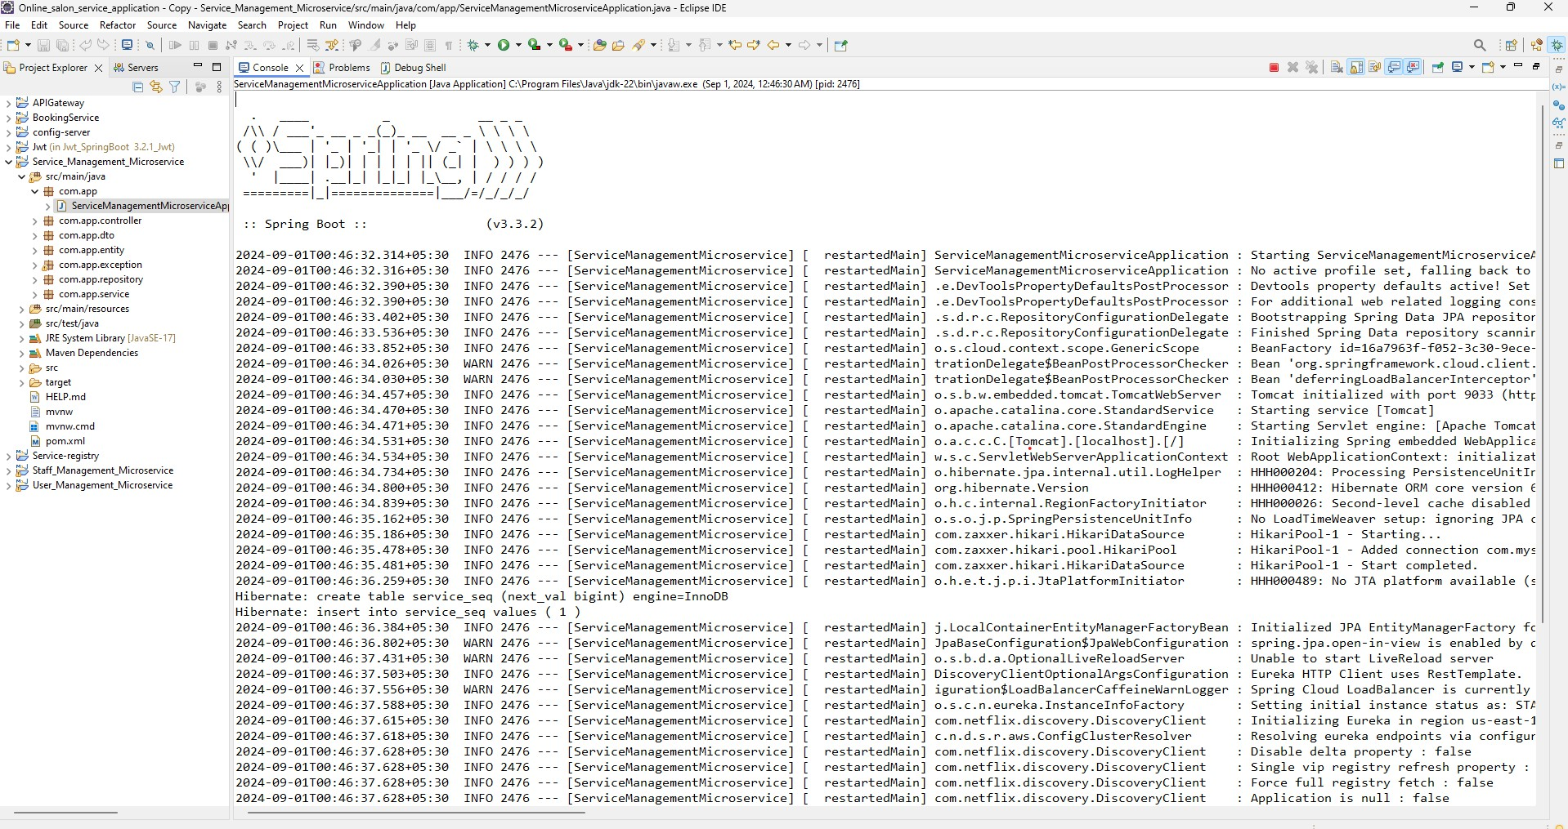
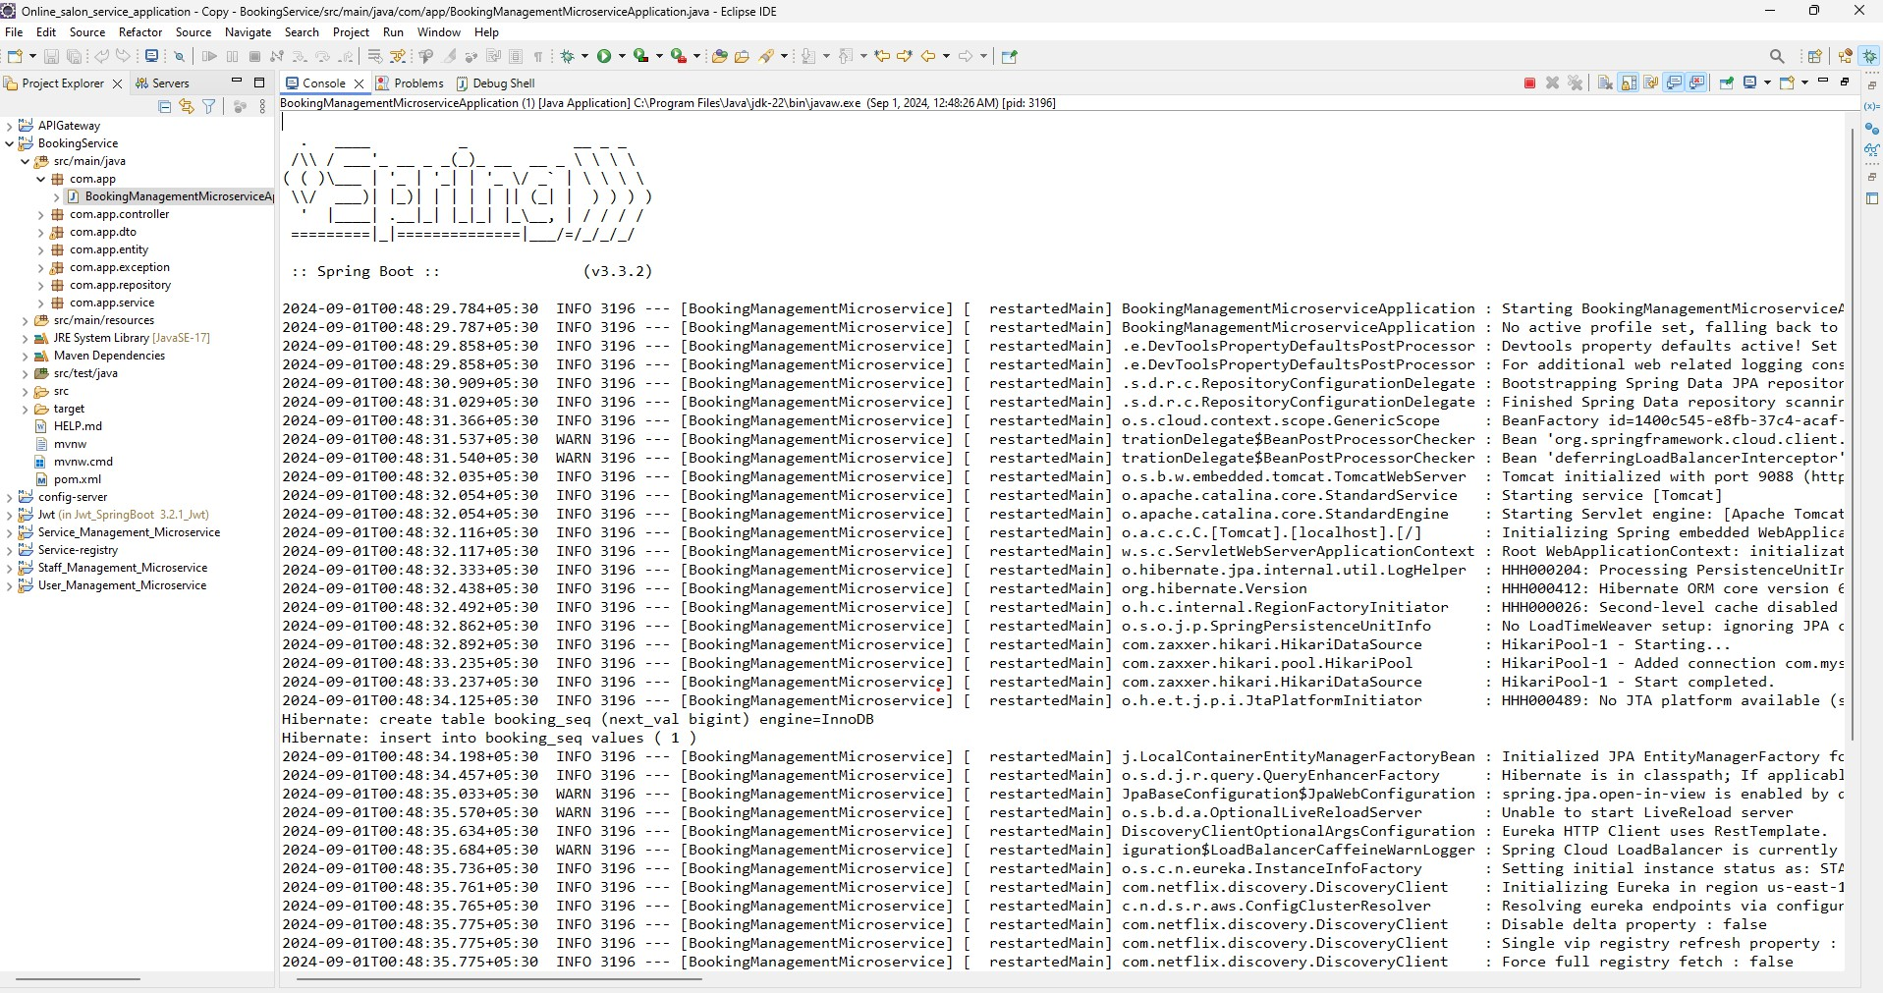
Running Service Management Microservice
Running Booking Management Microservice

Slide 12
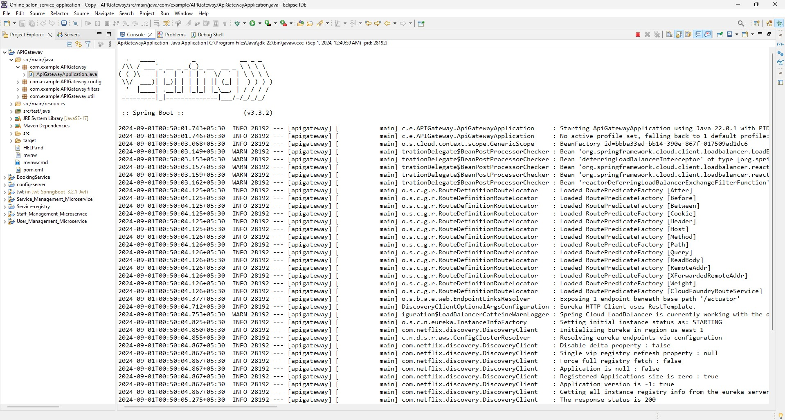
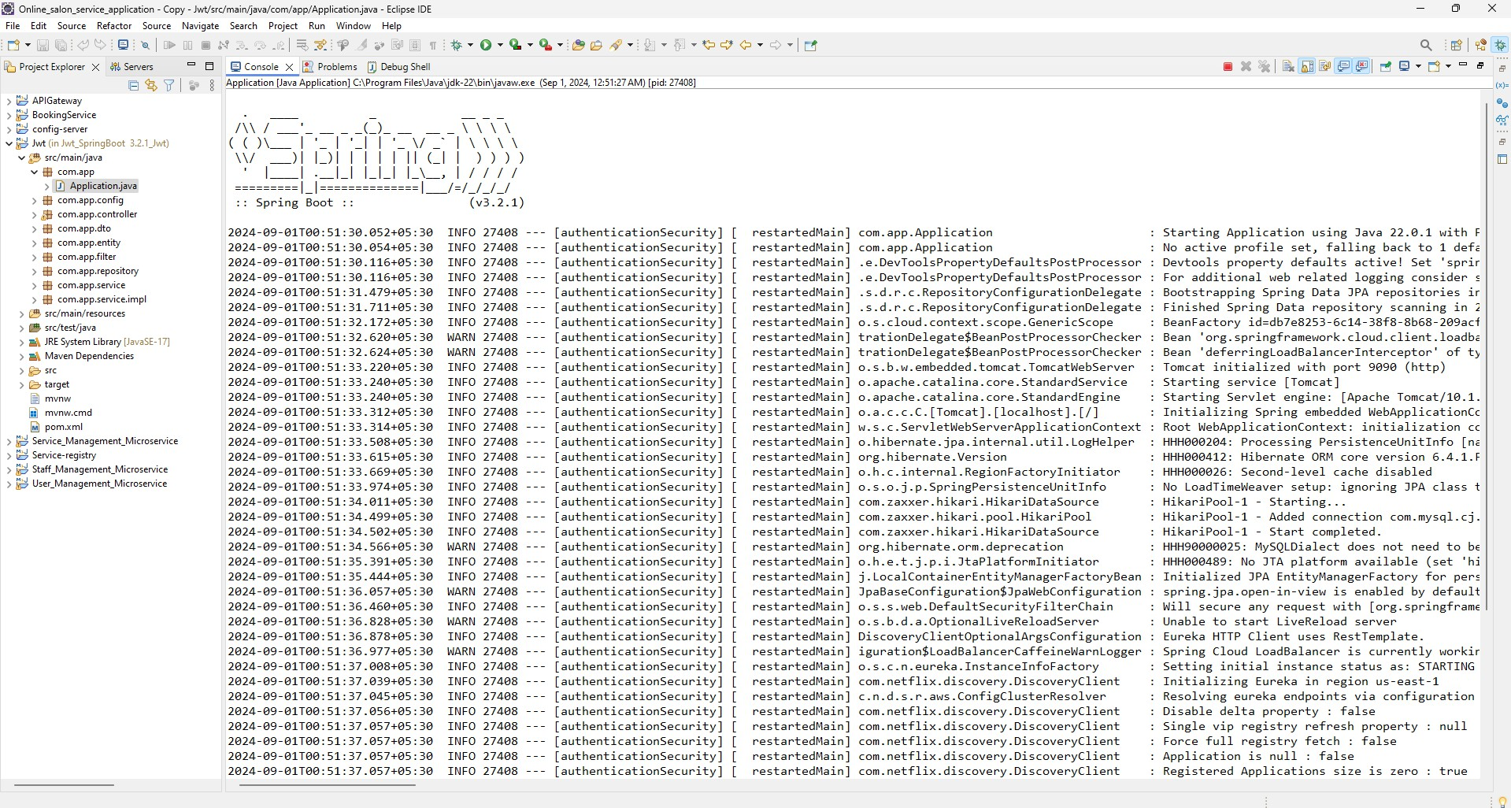
Running API Gateway
Running Authentication Security

Slide 13
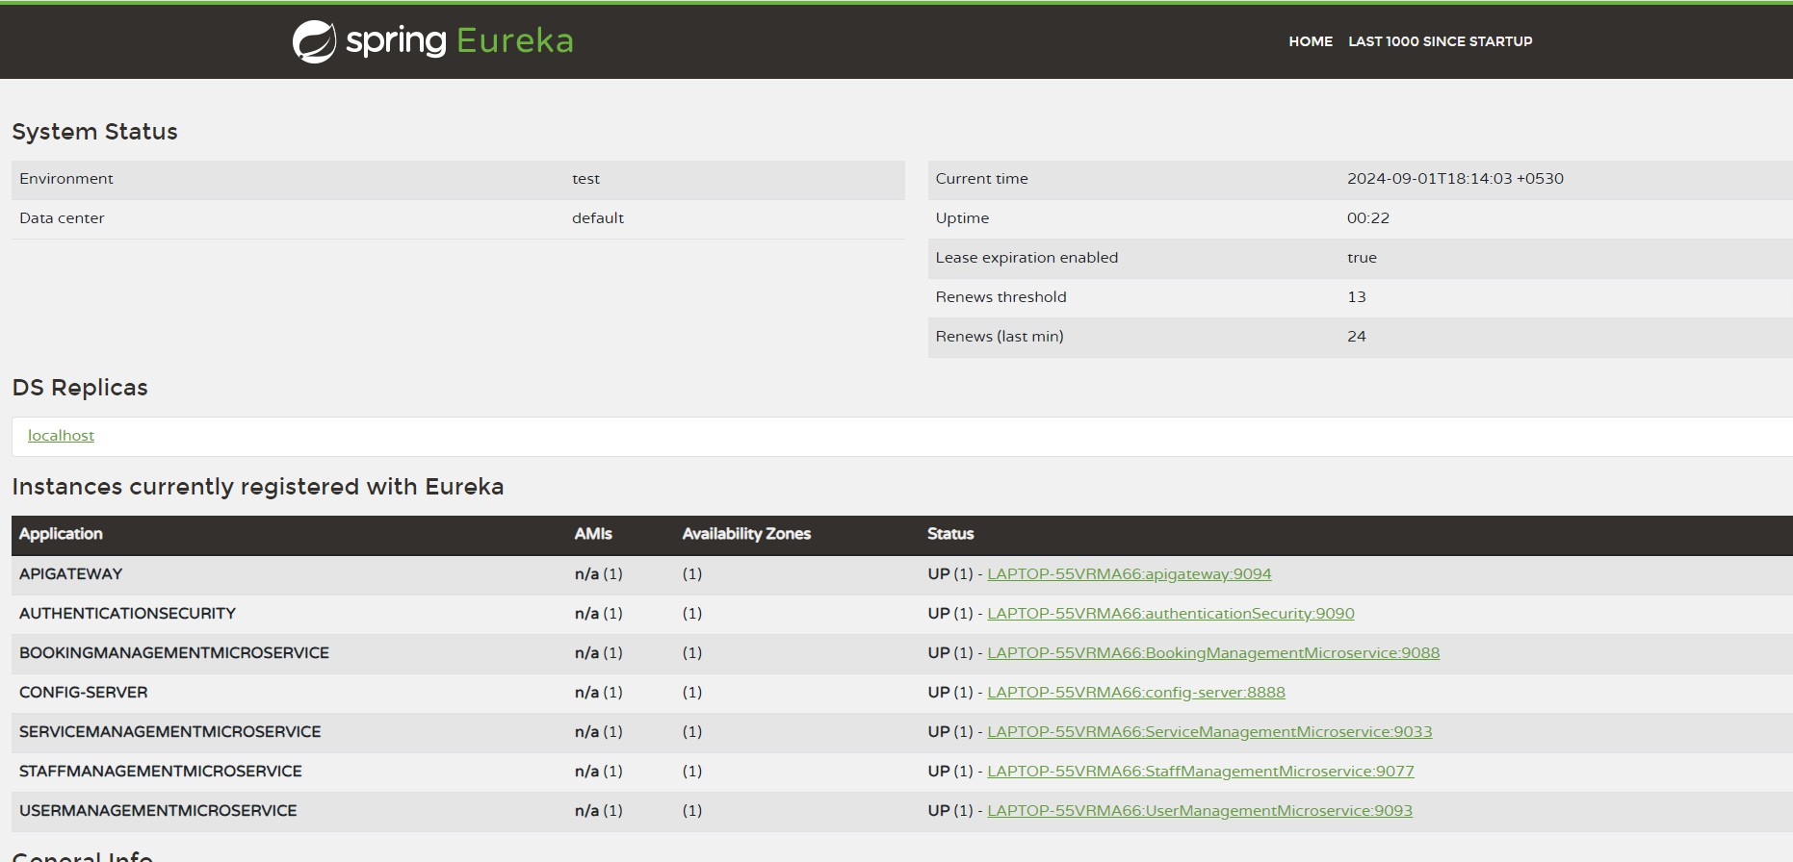
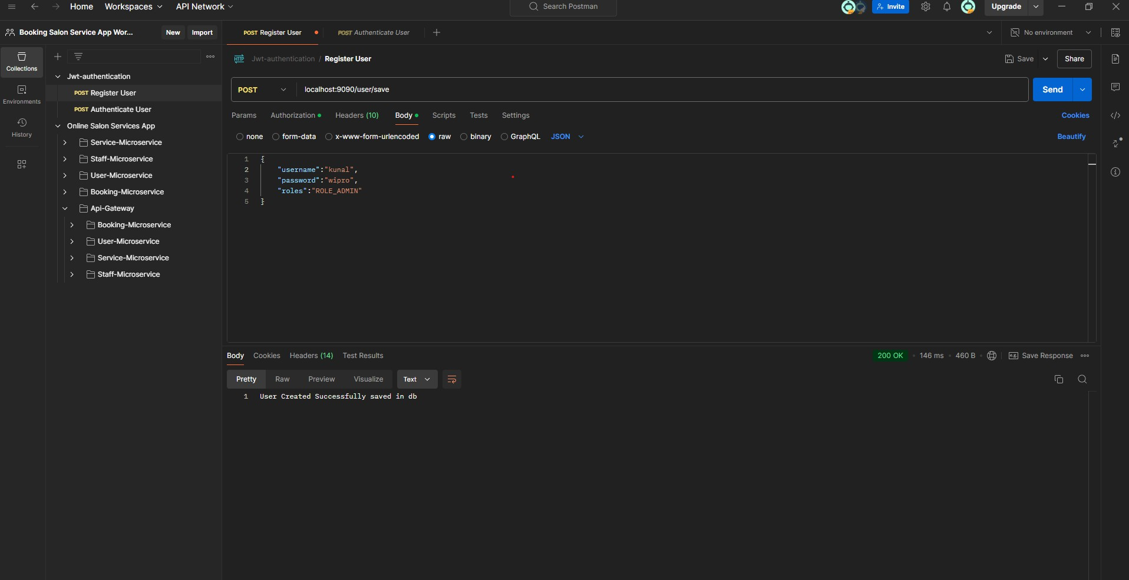
This is the Eureka Service where we show all Microservices:
Registrate User

Slide 14
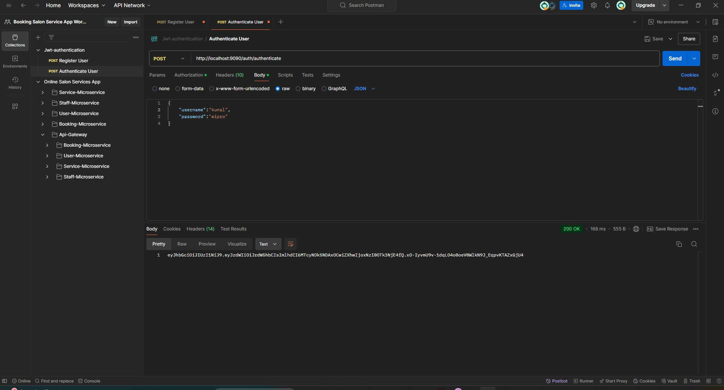
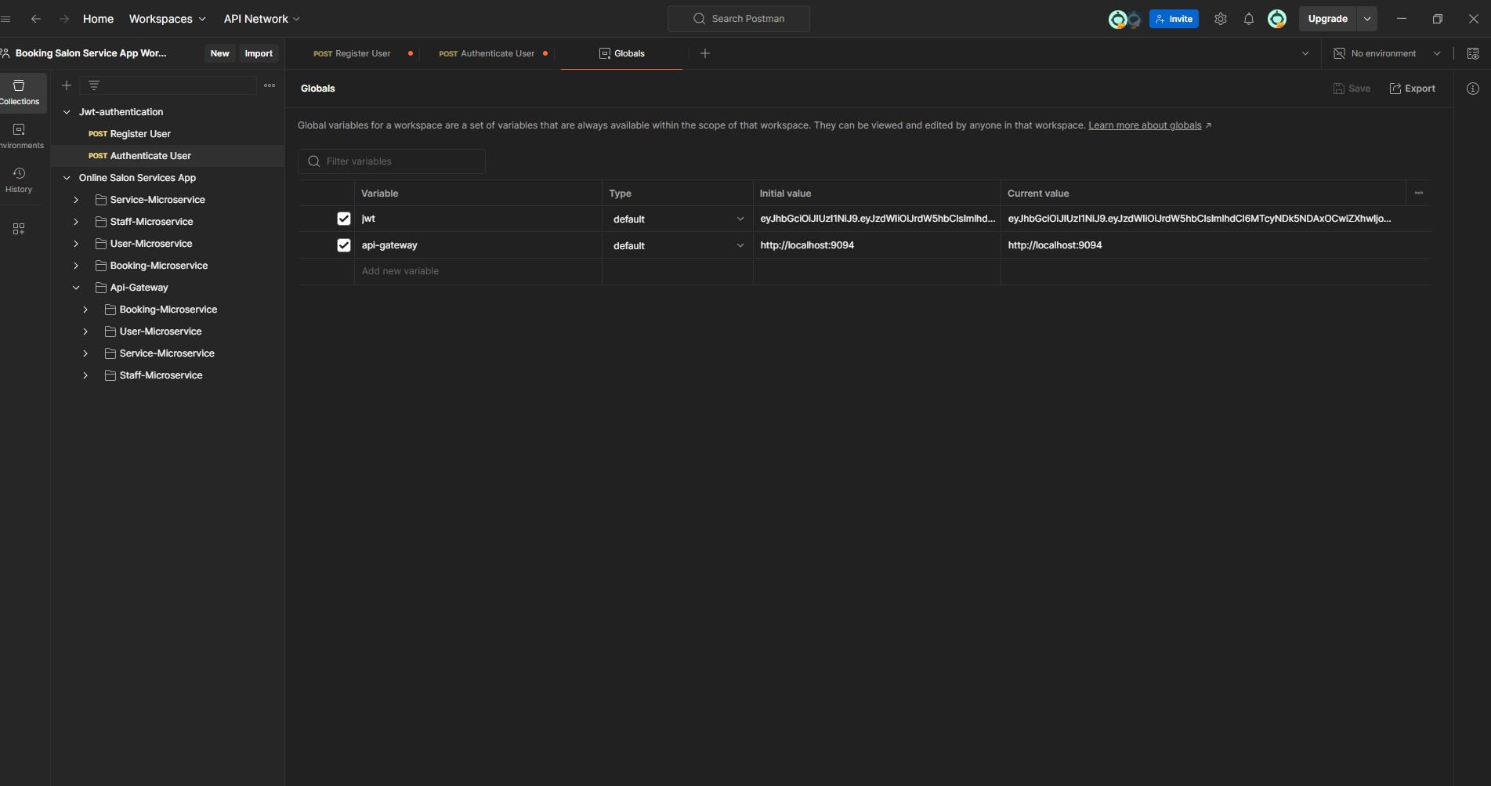
Login user
Putting this jwt token into environment

Slide 15
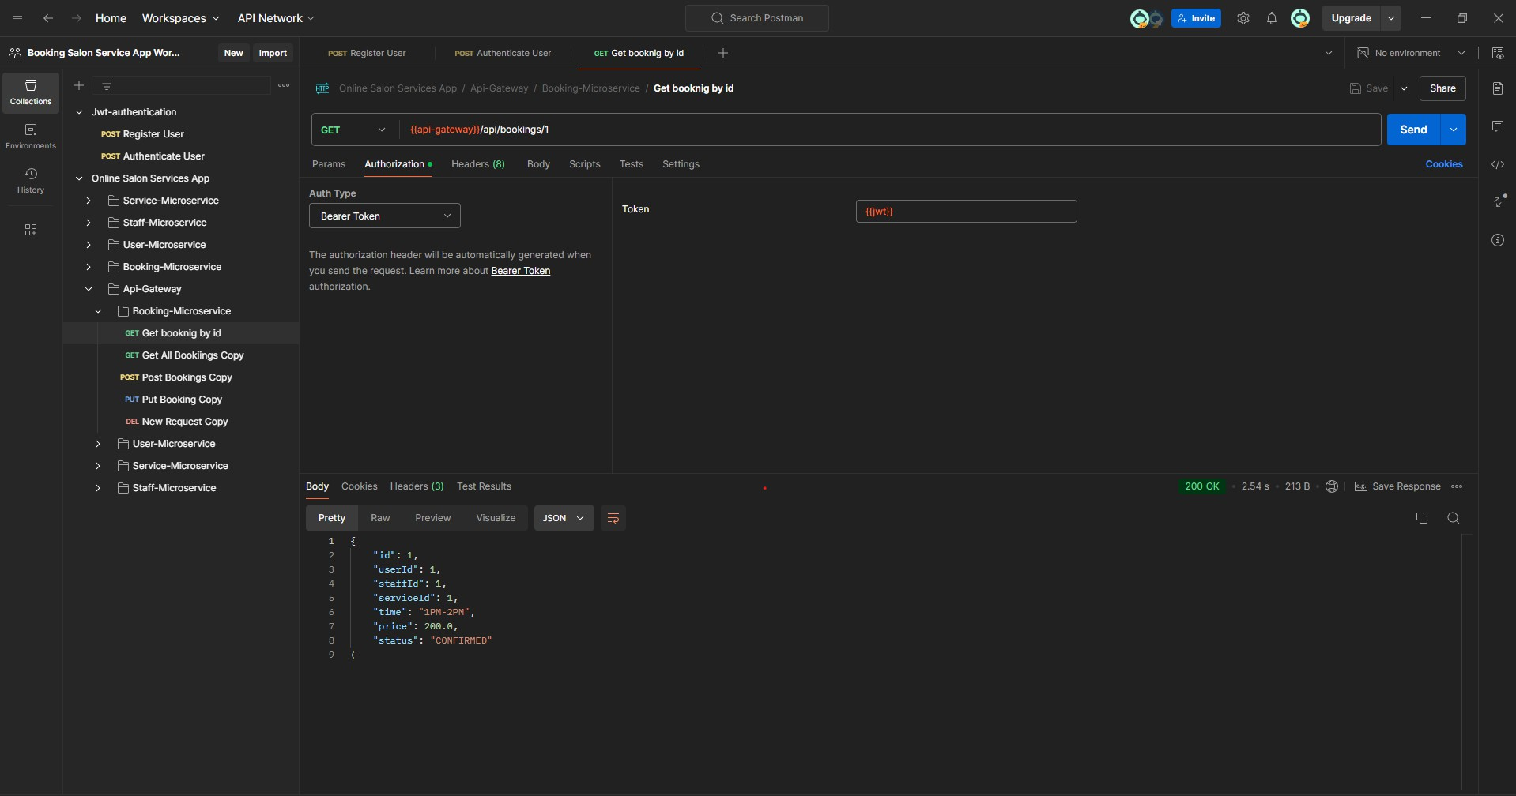
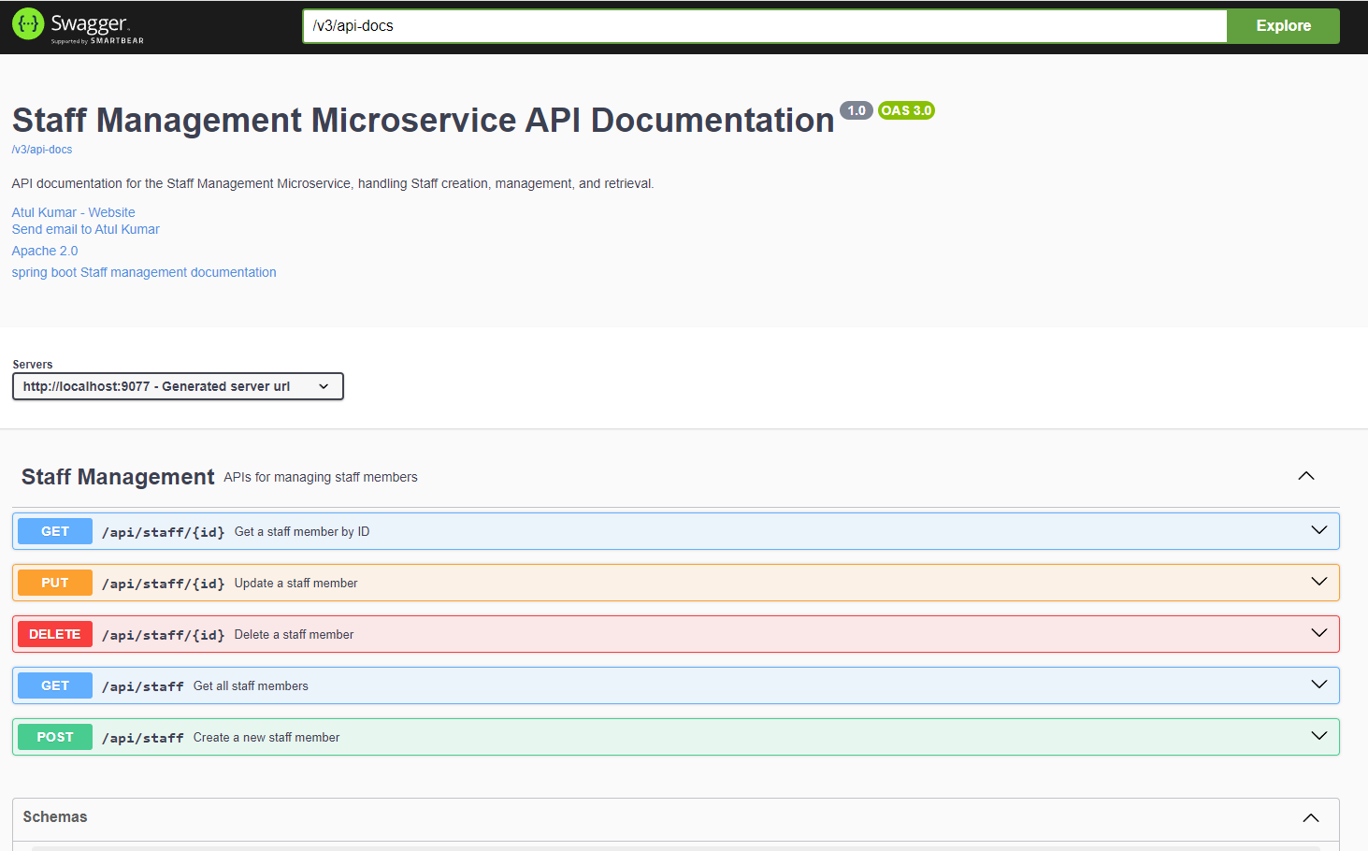
Using this token we perform operation and getting some information
Staff Microservices

Slide 16
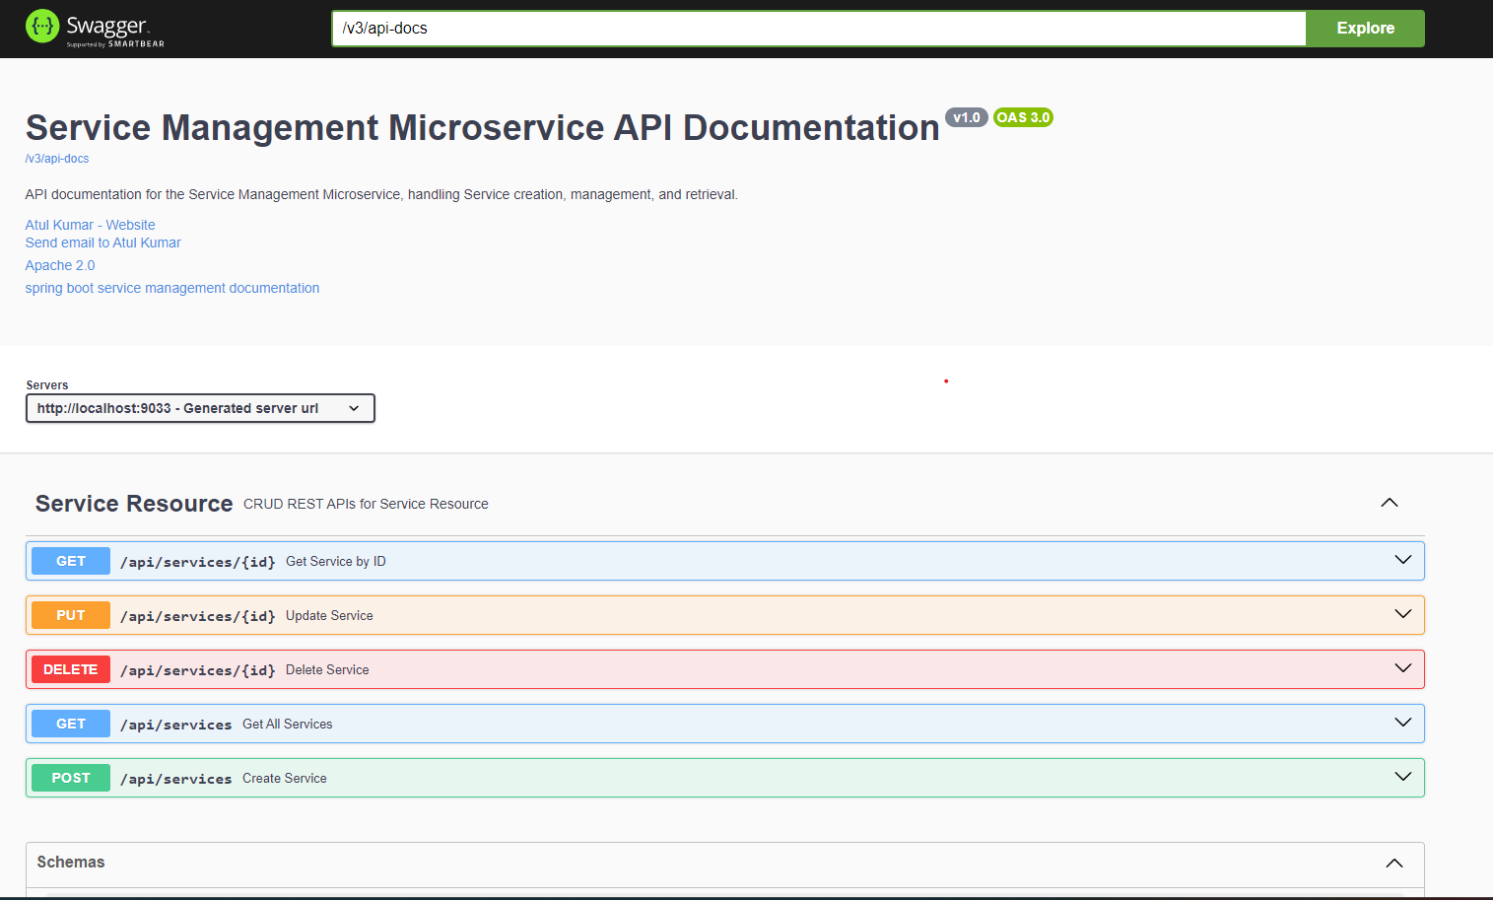
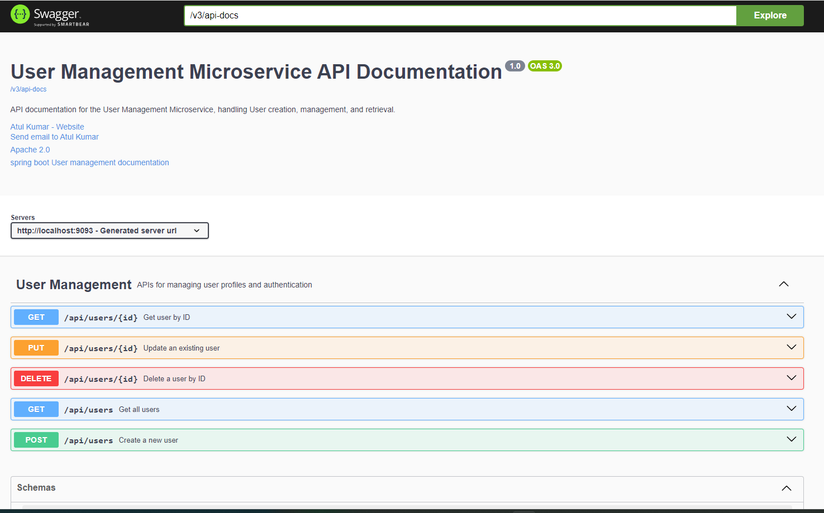
Service Microservices
Customer Microservices

Slide 17

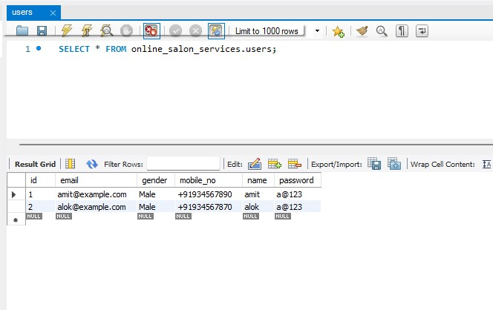
Booking Microservices
Customer Microservices
Database

Slide 18
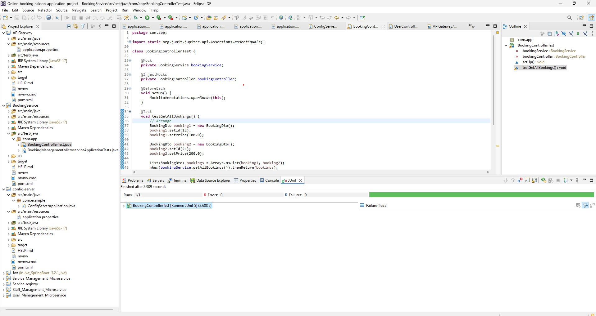
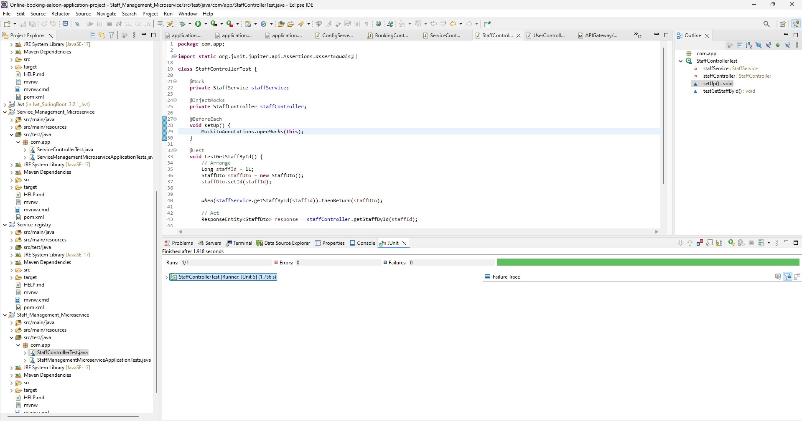
JUnit Booking Microservices
JUnit Staff Microservices

Slide 19
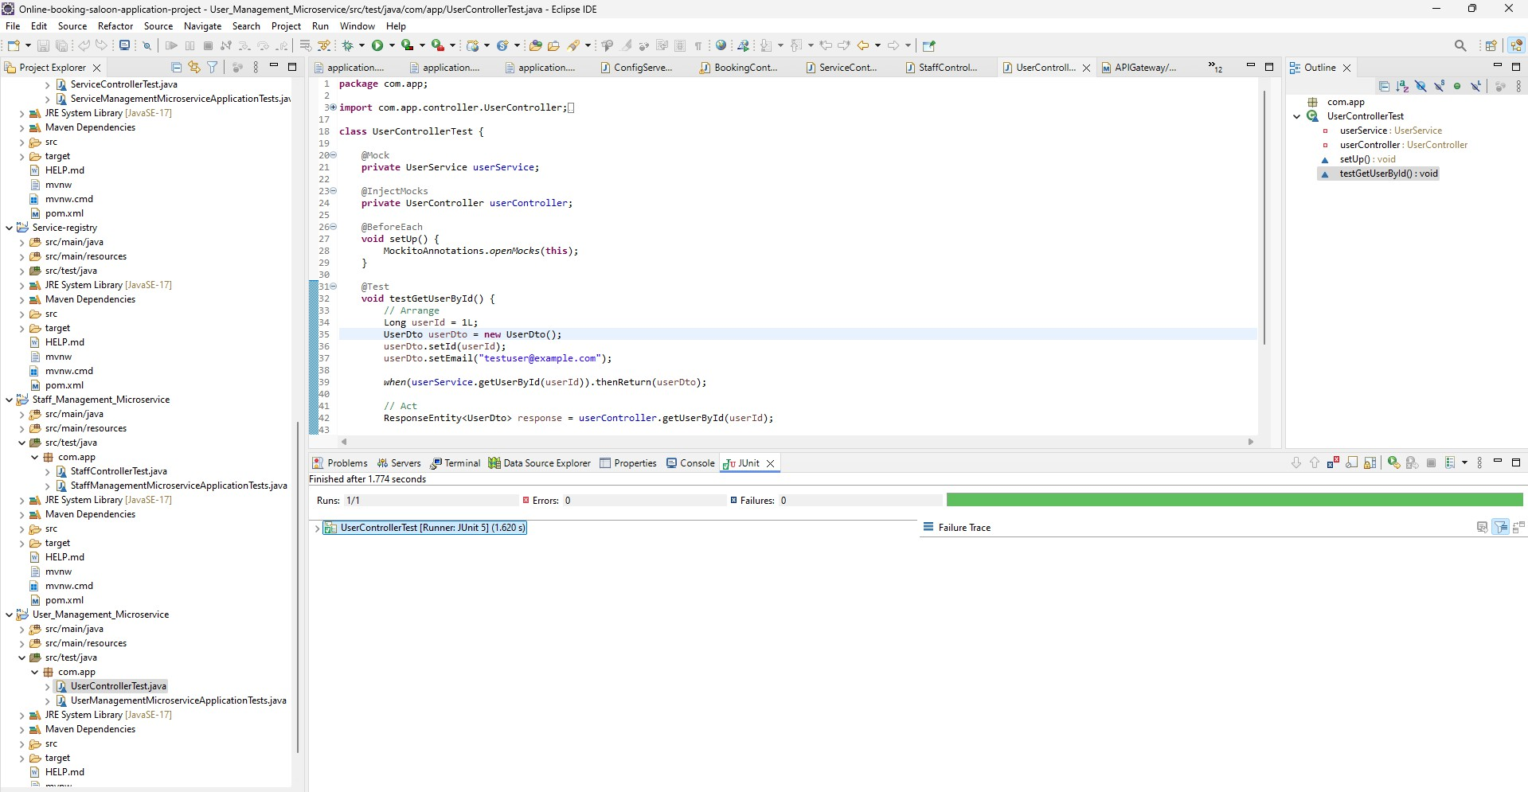
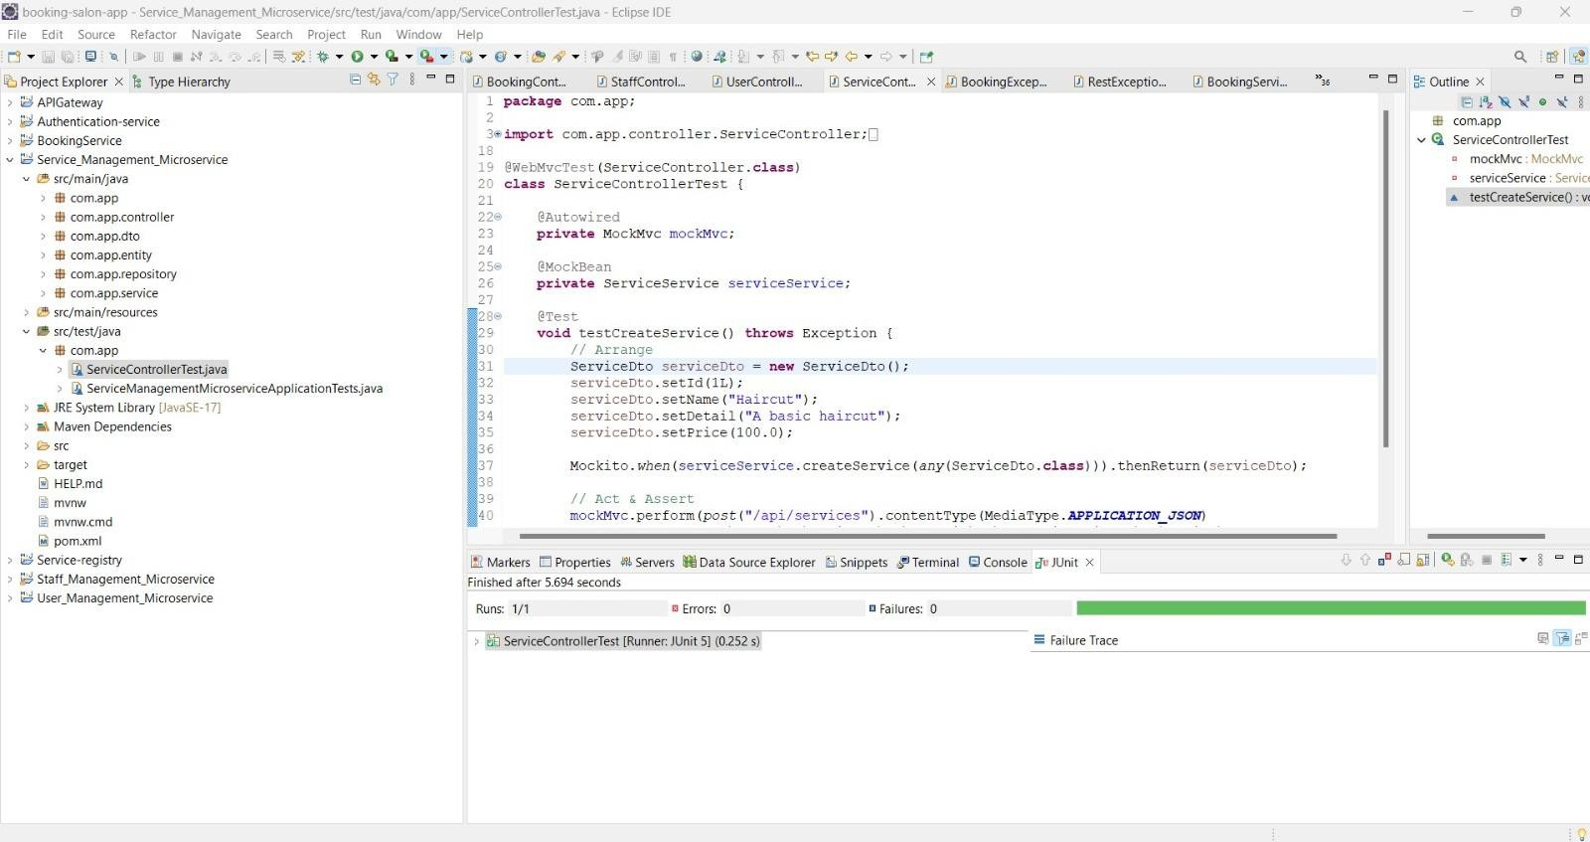
JUnit User Microservices
JUnit Service Microservices

Slide 20
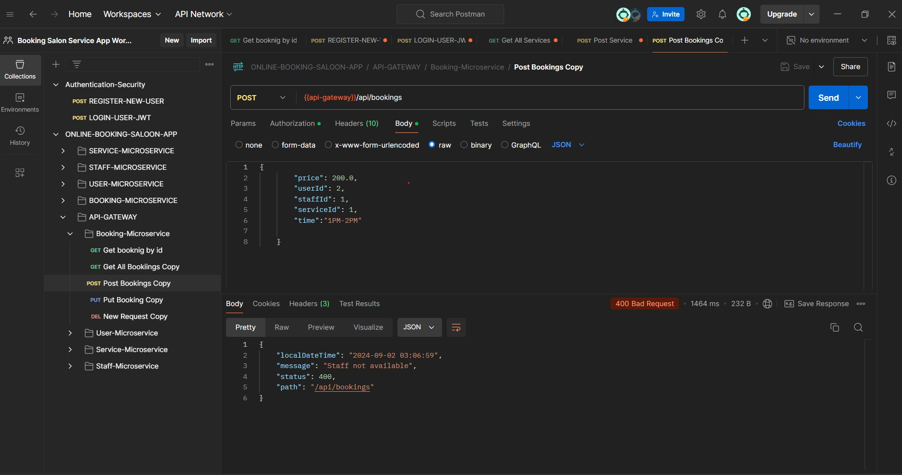
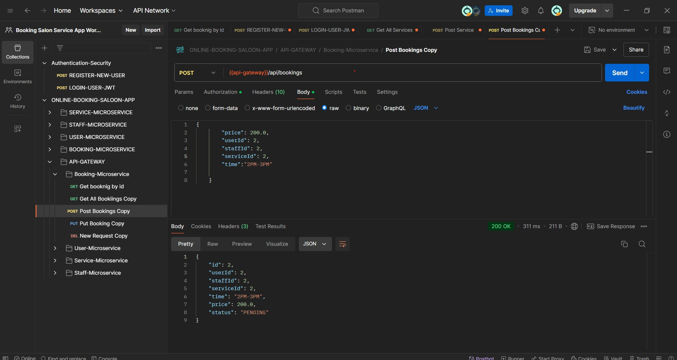
When Staff is not available then it showing Exceptional
Then we change the Staff booking timing Then it will be working

Slide 21
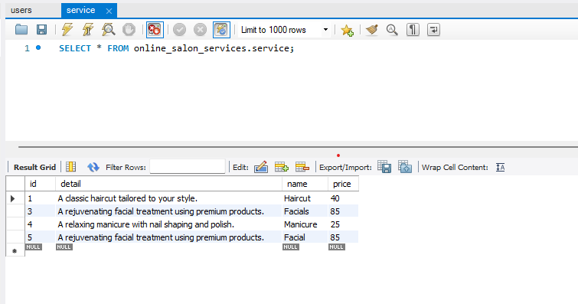
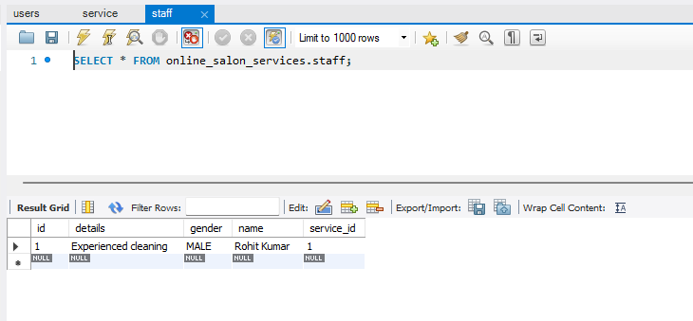
Service Microservices Database
Staff Microservices Database

Slide 22
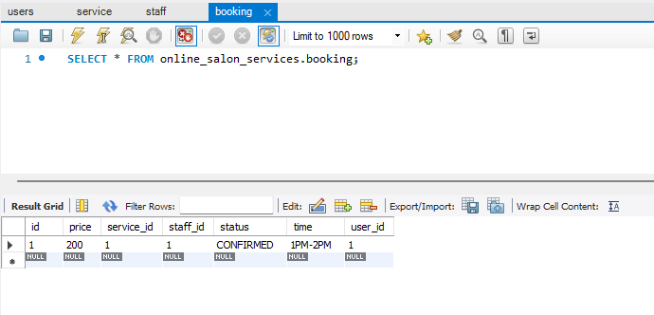
Booking Microservices Database

Slide 23
Thank You

